Slide 1




NONEYA
Stay Ahead. Alerted. Invested.
“Team 2 (noneya)”
MEMBER LIST
Jonathan corea
Srijan K
Austin Vas
Nash Fernandes

Slide 2
PROBLEM STATEMENT
Crypto Price Alert Assistant
Develop a lightweight app that monitors selected cryptocurrencies and sends alerts when prices cross certain thresholds.

Slide 3
Who faces this problem?
Active traders need immediate alerts to execute their time-sensitive buy and sell orders.
Long-term investors want notifications for major price swings to identify opportune moments to buy more or take profits.
Casual enthusiasts wish to track key movements in their holdings without the need for constant, active monitoring.

Slide 4
Why it matters (impact)?
Financially, it prevents missed opportunities for profit and helps users mitigate potential losses.
Psychologically, it reduces the stress and impulsive decisions that stem from constantly watching volatile charts.
For efficiency, it saves users significant time and mental energy by automating the price monitoring process.

Slide 5
Current limitations / pain points
Existing exchange apps suffer from app bloat, making them slow, complex, and a drain on battery life.
Users experience notification fatigue from irrelevant marketing, causing them to miss critical alerts.
Most apps offer poor customization, lacking advanced alert options like triggers based on percentage change.
These tools can be unreliable, with notifications that are delayed or fail entirely during high market volatility.
The ecosystem is fragmented, forcing users to manage multiple apps to track assets across different exchanges.

Slide 6
PROPOSED SOLUTION
Our solution is a minimalist and lightweight mobile application focused solely on delivering fast, reliable, and customizable cryptocurrency price alerts.
It is designed as a dedicated tool for traders and investors who need timely market information without the complexity of full-featured exchange apps.
The core principle of the app is to provide a clean, simple, and powerful alert system that performs its one job perfectly.

Slide 7
Key features
The app offers advanced alert conditions beyond simple price targets, including percentage changes over custom timeframes and alerts based on trading volume.
It features multi-source data aggregation, allowing users to monitor accurate prices from various centralized and decentralized exchanges in one place.
Our system is engineered to be extremely lightweight and efficient, ensuring minimal battery drain and data consumption on the user's device.
Users get granular control over notifications, enabling them to set custom sounds and priority levels to eliminate alert fatigue

Slide 8
Why is it better than alternatives?
Unlike cluttered exchange apps, our solution is purpose-built for alerts, providing a significantly faster and more intuitive user experience.
Our dedicated infrastructure ensures alerts are delivered instantly and reliably, overcoming the notification delays common in competitor apps during peak trading times.
It provides a unified monitoring system, eliminating the need for users to install and manage multiple apps to track a diverse portfolio.
By focusing exclusively on user-defined alerts, we cut out all notification noise, ensuring that every single alert is relevant and actionable.

Slide 9
Tech Stack
Frontend: NextJS
Backend: JS
DB / Tools: Supabase,Shadcn

Slide 10
DEMO / PROTOTYPE

Slide 11
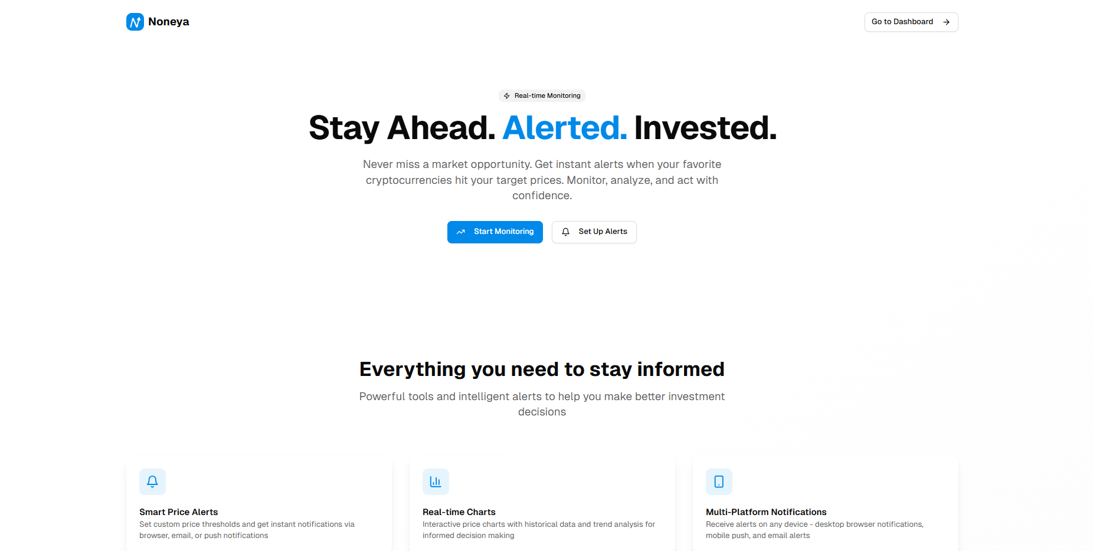
Main Page
The design highlights essential features like smart alerts, real-time charts, and multi-platform notifications to show how it keeps users informed.

Slide 12
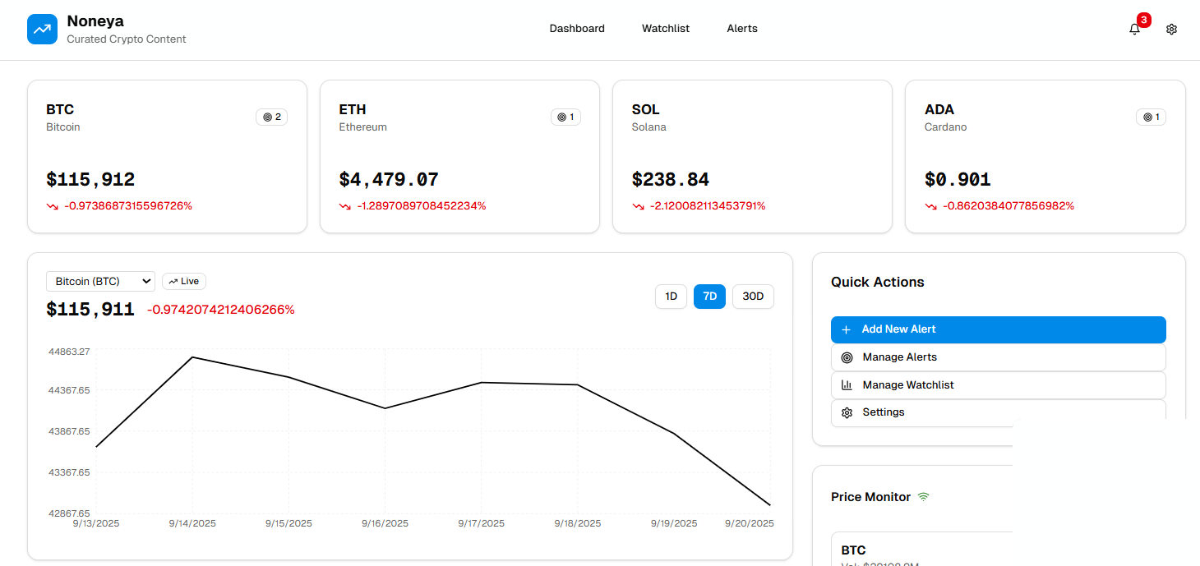
DashBoard
This is our project's main dashboard, designed to give you a clean overview of your crypto watchlist.
It displays live prices at a glance and provides a simple chart to visualize recent market trends.
The "Quick Actions" panel makes setting a new price alert fast and effortless.

Slide 13
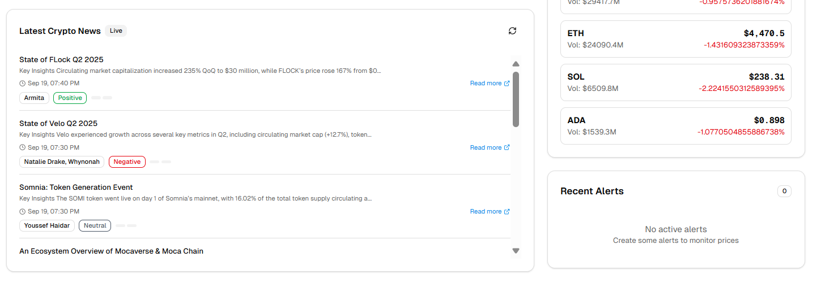
DashBoard
Below is a live crypto news feed with built-in sentiment analysis directly alongside the user's price tickers and alert history, providing deeper market context.

Slide 14
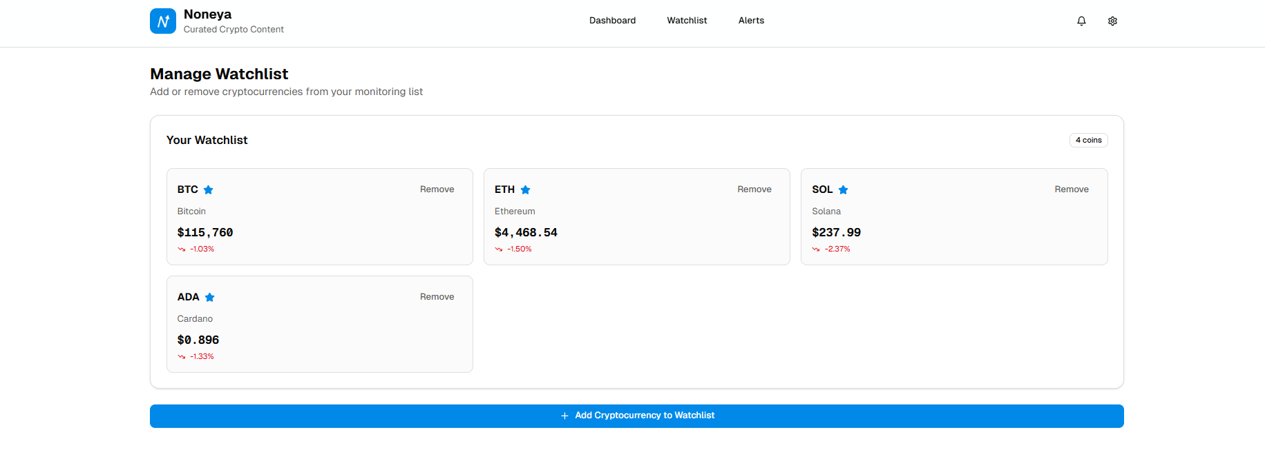
Watchlist
This is the "Manage Watchlist" page, where users control which cryptocurrencies they want to monitor.
The current watchlist is displayed in a clean grid, with each card showing essential price data for a coin.
Users can easily remove a coin directly from its card or use the large button at the the bottom to add new ones..

Slide 15
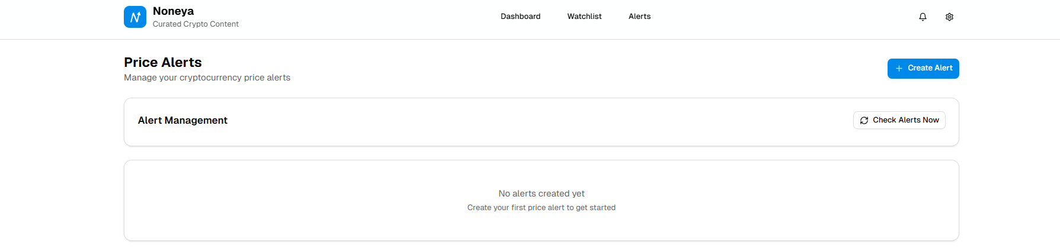
Alerts
This is the central "Price Alerts" screen, where users can view and manage all of their alert conditions.
The page currently shows an "empty state," clearly guiding a new user on how to get started.
The prominent "+ Create Alert" button is the main call to action, encouraging users to set up their first alert.

Slide 16
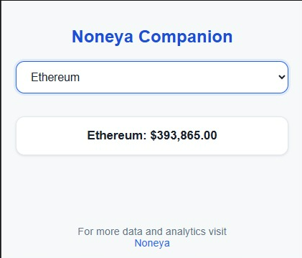
Chrome Extension
After a user selects a cryptocurrency, the Companion displays its live price and provides a direct link to the main Noneya application for more detailed analytics.

Slide 17
Who benefits?
Active traders and market analysts benefit directly from the speed and precision of the alerts, enabling more profitable and timely decisions.
Long-term investors and casual crypto holders benefit from the peace of mind that comes with automated monitoring, reducing stress and the fear of missing out.
Newcomers to cryptocurrency benefit from a simplified, focused tool that helps them learn market dynamics without the intimidating complexity of a full trading platform.

Slide 18
Short-term & long-term impact
In the short term, our app will immediately empower users by saving them time, reducing anxiety, and helping them capitalize on market opportunities they would otherwise miss.
Our initial impact will also be to establish a loyal user base that trusts our app for its superior speed and reliability over incumbent, bloated solutions.
The long-term impact is to become the industry-standard tool for all event-driven crypto notifications, expanding beyond price to include on-chain metrics and social sentiment.
Ultimately, we aim to foster a more data-driven investment community by providing accessible tools that encourage planned strategies over emotional reactions.

Slide 19
Roadmap / scaling ideas
Our immediate roadmap is to launch the core application on iOS and Android, focusing on stability, speed, and integrating with the top 10 cryptocurrency exchanges.
In the next phase, we will expand our feature set to include advanced alert triggers, such as those based on technical indicators and significant on-chain wallet movements.
For long-term scaling, we plan to introduce a premium subscription tier for professional users and develop a B2B API to serve trading bots and financial platforms.

Slide 20
THANK YOU

